Slide 1
INFOTRUST
~Deep Learning & NLP for News Credibility Analysis
A Multi-Dataset Framework for Misinformation & Trustworthiness Evaluation
Team Members: Guideness By:
Lingala Anwesh [B200462] Assistant Proffesor Santhapuri Nishanth [B200628] Mrs. Govaradhani Kummari
Pittala Mahesh [B200240]
Notes:
1

Slide 2

The Challenge of Digital Trust
The proliferation of digital platforms has unfortunately led to spread of fake news and misinformation. This erodes public trust, influences critical decisions, and can have far-reaching societal consequences. Our project addresses this urgent need for a reliable mechanism to assess news credibility.
Our proposed solution is a multi-dataset, Deep Learning, and Natural Language Processing (NLP) framework designed to analyze and evaluate news credibility. This comprehensive approach provides a robust defense against the tide of misinformation.
The applications of this framework are vast, benefiting journalism, social media platforms, and policy-making bodies by providing tools for rapid and accurate content evaluation.
Notes:
2

Slide 3
Leveraging Diverse Datasets
To build a robust and generalizable model, we consolidate information from multiple, distinct datasets, creating a comprehensive foundation for credibility analysis.
FakeNewsNet
LIAR Dataset
Comprises news articles from GossipCop and PolitiFact, including news titles, full articles, and associated tweet interactions. It offers a rich source for analyzing real-world news propagation.
Features short political statements with fine-grained credibility labels (e.g., true, false, pants-on-fire), primarily focused on political discourse.
Kaggle Fake News Dataset
Combined Dataset
Merging these sources creates a robust dataset of over 50,000 samples, addressing schema mismatches and class imbalance to ensure high-quality training data.
Contains a large collection of articles explicitly labeled as "fake" or "real," serving as a fundamental binary classification source.
Notes:
3

Slide 4

Data Pipeline: From Raw to Refined
Effective preprocessing is crucial for transforming raw text and metadata into features suitable for machine learning and deep learning models.
Raw Dataset
Text Cleaning
Tokenization
Feature Extraction
Class Imbalance Handling
Feature Vectorization
Many real-world datasets suffer from class imbalance (e.g., far more "real" news samples than "fake"). We address this using techniques like undersampling the majority class or oversampling the minority class to prevent model bias.
Text is converted into numerical representations using techniques like Bag-of-Words (BoW), TF-IDF, and advanced word embeddings (Word2Vec, GloVe) for deep learning models. For Transformers, tokenized input is generated.
Notes:
4

Slide 5
System Architecture
Our InfoTrust framework processes news content through a multi-stage pipeline to deliver a comprehensive credibility assessment.
Notes:
5

Slide 6
Stage 1: Establishing Baseline with Machine Learning
In the initial phase, we establish performance baselines using classical Machine Learning (ML) models, providing a crucial reference point for the advanced models to be developed in Stage 2.
Model Selection
Training & Evaluation
Performance Benchmarking
We employ a suite of classical ML classifiers: Logistic Regression (a linear baseline), Naïve Bayes (a probabilistic model), Random Forest (a tree-based ensemble known for robustness), and XGBoost (a powerful gradient boosting algorithm).
Models are trained on the preprocessed, combined dataset. Performance is evaluated using standard metrics: Accuracy, Precision, Recall, F1-score, and Area Under the ROC Curve (AUC). Hyperparameter tuning, such as GridSearchCV, is applied to optimize model performance and mitigate overfitting.
The results from these ML models provide a baseline performance comparison. This allows us to quantify the improvements achieved by more complex Deep Learning and Transformer models in subsequent stages.
These models serve as a foundational step, helping us understand the inherent challenges and initial performance ceilings before moving to more complex architectures.
Notes:
6

Slide 7
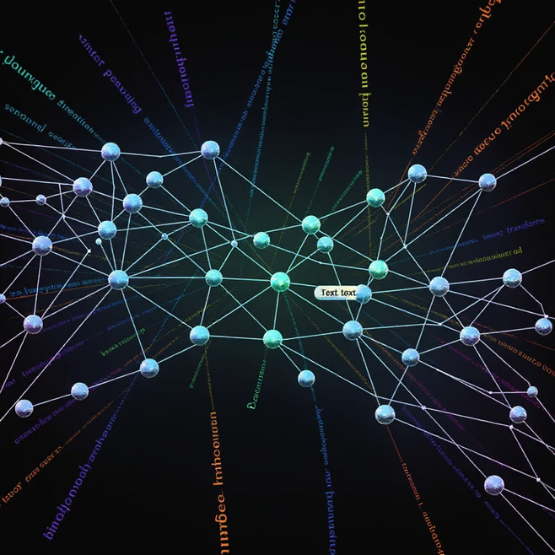
Stage 2: Advancing with Deep Learning & Transformers
Building on our baseline, Stage 2 introduces advanced Deep Learning (DL) and Transformer models to capture more complex textual patterns and contextual information for enhanced credibility analysis.
Deep Learning Models
We implement BiLSTM (Bidirectional Long Short-Term Memory) and GRU (Gated Recurrent Unit) networks. These models excel at capturing long-term dependencies and sequential information in text, overcoming the vanishing gradient problem common in traditional RNNs.
Transformer Models
We fine-tune state-of-the-art Transformer architectures such as BERT (Bidirectional Encoder Representations from Transformers) and RoBERTa (Robustly optimized BERT approach). These models leverage attention mechanisms to understand contextual relationships between words, leading to highly accurate classifications.
Multimodal Fusion
A key advancement is exploring multimodal fusion, combining insights from text, metadata (like user interactions), and potentially images to create a richer feature set for our models.
These advanced models are crucial for achieving state-of-the-art performance and overcoming the limitations of simpler ML approaches, especially in capturing nuanced language patterns indicative of misinformation.
Notes:
7

Slide 8
Beyond Content: Source Credibility Analysis
A crucial extension in Stage 2 is integrating source credibility, moving beyond just the content to evaluate the trustworthiness of news origins and propagation networks.
Domain Credibility Scoring
User Engagement Credibility
Author Reliability
Analyzing user interactions (likes, shares, comments) and their networks provides insights into how misinformation spreads. Graph Neural Networks (GNNs) like GCN (Graph Convolutional Networks) and GAT (Graph Attention Networks) can model these propagation patterns.
We assign credibility scores to news domains and sources based on their historical reliability, alignment with fact-checking organizations, and past instances of spreading misinformation. This is a vital meta-feature for the overall assessment.
Evaluating the past record of authors, including their publication history and any known biases or previous involvement in spreading false information, contributes to a more holistic credibility score.
This holistic approach to credibility analysis helps identify coordinated disinformation campaigns and assess the trustworthiness of the entire news ecosystem, not just individual articles.
Notes:
8

Slide 9
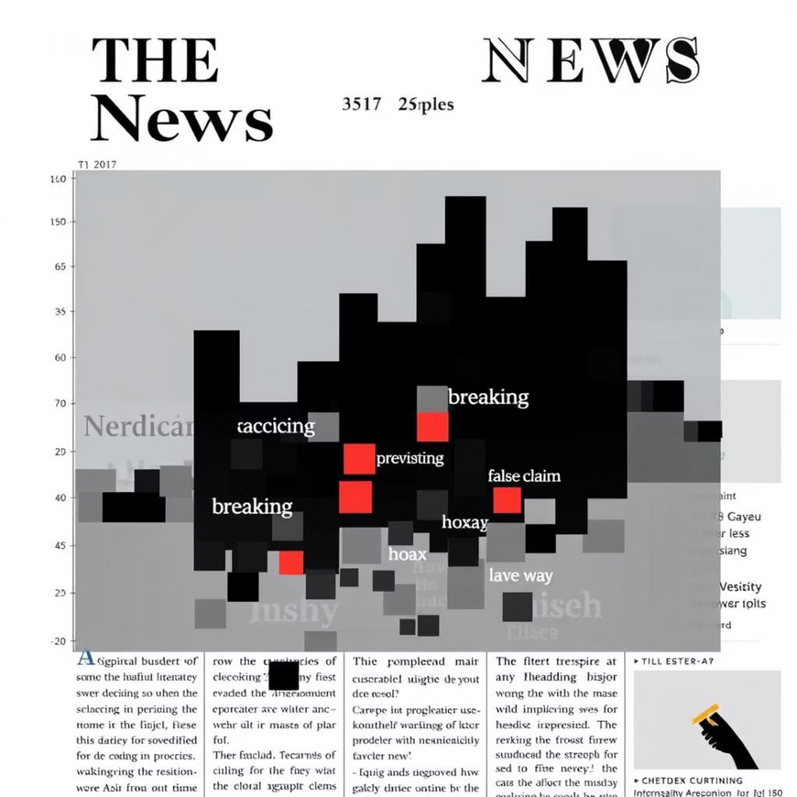
Explainable AI (XAI): Trust and Transparency
To build a trustworthy system, especially for sensitive applications like credibility analysis, understanding *why* a model makes a certain prediction is as important as the prediction itself.
1
LIME & SHAP
We utilize LIME (Local Interpretable Model-agnostic Explanations) and SHAP (SHapley Additive exPlanations) to explain individual predictions. These techniques attribute feature importance to words or phrases, showing their contribution to the model's output.
2
Attention Heatmaps
For Transformer models like BERT, we generate attention heatmaps. These visual representations highlight which words or tokens the model "focused" on when making its classification, providing intuitive insights into the model's decision-making process.
3
Model Interpretability
By implementing XAI, our framework transforms from a black-box system into a transparent, understandable tool. This is crucial for research credibility and for users to trust the credibility scores provided.
Attention Heatmap: Visualizing word importance.
Notes:
9

Slide 10



Future Horizons & Project Impact
The InfoTrust framework has significant potential for further expansion and real-world impact.
Real-time Monitoring
Multi-Lingual Support
Platform Integration
Integrate with social media APIs (e.g., Twitter, Reddit) for real-time ingestion and credibility analysis of trending news. This moves beyond batch processing to proactive detection.
Extend the framework to support multiple languages using multilingual Transformer models (e.g., mBERT, XLM-R), addressing misinformation globally.
Develop browser extensions or direct integrations with social media platforms, providing instant credibility assessments to users as they browse news feeds.
Scalable Deployment
Transition the prototype (Streamlit/Django web app) to a robust, cloud-based deployment (AWS, Heroku) for high availability and scalability, supporting large-scale usage.
Societal Impact & Research Contribution
InfoTrust aims to empower journalists, policymakers, and the public with tools to navigate the complex information landscape. Our multi-dataset, credibility-aware, and explainable framework offers a significant research contribution to the fight against misinformation.
Notes:
10

Slide 11
References
F. G. Hussain, M. Wasim, S. Hameed, A. Rehman, M. N. Asim, and A. Dengel,“Fake News Detection Landscape: Datasets, Data Modalities, AI Approaches, Their Challenges, and Future Perspectives,”IEEE Access, vol. 13, pp. 54757–54770, 2025.DOI: 10.1109/ACCESS.2025.3553909
A. Shu, S. Sliva, S. Wang, J. Tang, and H. Liu,“Fake News Detection on Social Media: A Data Mining Perspective,”ACM SIGKDD Explorations Newsletter, vol. 19, no. 1, pp. 22–36, 2017.DOI: 10.1145/3137597.3137600
K. Shu, D. Mahudeswaran, S. Wang, D. Lee, and H. Liu,“Fakenewsnet: A Data Repository with News Content, Social Context and Dynamic Information for Studying Fake News on Social Media,”arXiv:1809.01286, 2018.Link: https://arxiv.org/abs/1809.01286
Z. Zhou, J. Wu, and W. Zeng,“Fake News Detection via NLP is Vulnerable to Adversarial Attacks,”Proceedings of ACL, 2020.Link: https://aclanthology.org/2020.acl-main.436/
Notes:
11

Slide 12
THANK YOU
Notes:
12

